Slide 1



Regulatory processes in North America and Europe
Standards and regulations
Conformity assessment agency
Requirements at each stage of the life cycle
17.3.1 Regulatory processes in North America and Europe
Unit C 17.3 Global Medical Equipment Regulations
Module 279-17-C Regulations, Standards and Ethics
dr. Chris R. Mol, BME, NORTEC, 2015

Slide 2
What Regulations cover (repeat)
Product
  device attributes (safety, performance)
  manufacturing (quality, incl. packaging)
  labelling (representation)
Sale
  establishment registration
  advertising (representation)
Use
  after sale obligations
  monitoring of clinical performance
  problem identification and alerts
©
Government Regulatory Agencies
dr. Chris R. Mol, BME, NORTEC, 2015

Slide 3
What Regulations cover (repeat)
‘After sale obligations’
Vendors: user training,.
Manuf.: spare parts,..
User: safe disposal…
©
Government Regulatory Agencies
dr. Chris R. Mol, BME, NORTEC, 2015

Slide 4
Common Medical Device Regulations
A good number of Medical Device regulations are common across much of the world.
This is partly due to the harmonization activities that have taken place over the last 20 or so years.
Example of common regulations:
  it is prohibited to sell or advertise a device before it is cleared to enter the market (by the regulatory authorities of that market).
  it is prohibited to publish misleading or fraudulent advertisement.
  problem reporting is required.
  records of distribution need to be maintained.
  a recall procedure must be available.
  complaint handling must be performed.
The contours of these common regulations have been presented in section 17-2.
©
Regulatory in US and Europe
dr. Chris R. Mol, BME, NORTEC, 2015

Slide 5
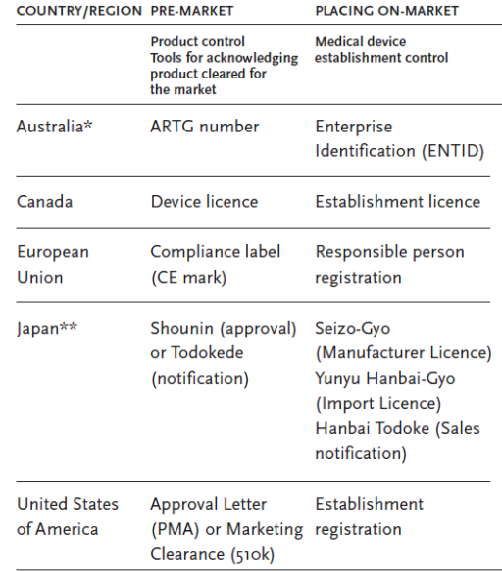
Country differences
In this section we focus on medical device regulation in major markets USA and EU.
Other developed markets such as Japan, Canada and Australia have much the same regulation with differences mainly in nomenclature (name giving).
Further harmonization is expected to diminish regional differences, reducing the bureaucratic load on governments and manufacturers / vendors
©
Regulatory in US and Europe
dr. Chris R. Mol, BME, NORTEC, 2015

Slide 6
EU

Slide 7
EU Legal Framework (repeat)
The (mandatory) Medical Device Directive 93/42/EEC of 14 June 1993 concerning medical devices,
harmonises the laws relating to medical devices within the European Union.
The government of each Member State (e.g. the Netherlands, France, …) must appoint a competent authority (CA) responsible for medical devices. The competent authority is a body with authority to act on behalf of the Member State to ensure that Member State government transposes requirements of (EU-level) medical device directives into national law and applies them.
The CA reports to the minister of health in the Member State.
©
Government Regulatory Agencies
dr. Chris R. Mol, BME, NORTEC, 2015

Slide 8


Product Control
CE Mark
The authorization of medical devices is guaranteed by a Declaration of Conformity.
This declaration is issued by the manufacturer itself.
Medical devices that fit in class I can be marketed purely by self-certification.
For products in higher classes, it must be verified by a Certificate of Conformity issued by a Notified Body.
A Notified Body is a public or private organisation that has been accredited to validate the compliance of the device to the European Directive.
examples of notified bodies
All certified medical devices must have the CE mark
©
Government Regulatory Agencies
dr. Chris R. Mol, BME, NORTEC, 2015

Slide 9
Declaration of Conformity for Medical Devices
If you sell medical devices in Europe (any class) you must prepare an EU Declaration of Conformity (DOC).
The elements that should be included in the Declaration of Conformity include:
  Name of the device, including model number and trade name.
  Manufacturer name and address.
  Name of company quality management representative.
  Name and identification number (if applicable) of your Notified Body.
  Name, address and telephone number of your European Authorized Representative.
  Your CE Marking certificate number (if applicable).
  Your conformity assessment route to compliance. List the Annex, classification and rule number (rule number only applies to the Medical Device Directive).
  Standards that have been applied (optional)
  Name and signature of a senior management representative and date signed.
this slide serves as an example of the administrative details that are inherent to these regulations.
©
Government Regulatory Agencies
dr. Chris R. Mol, BME, NORTEC, 2015

Slide 10
EU Product Classification
Product Control
EU Product classification based on:
  does the device come in contact with the human body
  the degree of invasiveness (penetration of the body either through a body orifice or via the surface of the body;
  if the device is non-invasive then contact with blood is an important criterion.
  duration of use: transient use (less than 1 hour), short term use (from 1 hour to 30 days) and long term use (> 30 days)
  anatomy affected: in contact with vital organs
  activated by an energy source.
These criteria are applied to the intended use, not to the technical characteristics.
The responsibility for classification rests with the manufacturers and must be based on the published decision tree (next page).
Class I: Lowest level/responsibility for compliance under the manufacturer
Class II a: Mainly control of production (manufacturing)
Class II b: Both design and production control
Class III: Highest level: pre-market approval
©
Regulatory in US and Europe
dr. Chris R. Mol, BME, NORTEC, 2015

Slide 11
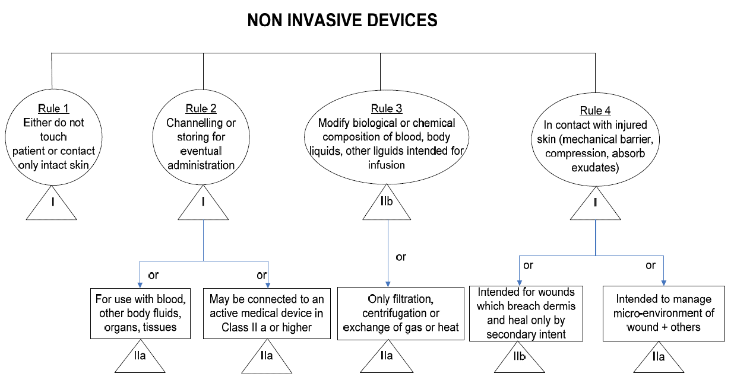
EU Rule Based device classification (example repeat from 17.1)
©
Government Regulatory Agencies
dr. Chris R. Mol, BME, NORTEC, 2015

Slide 12
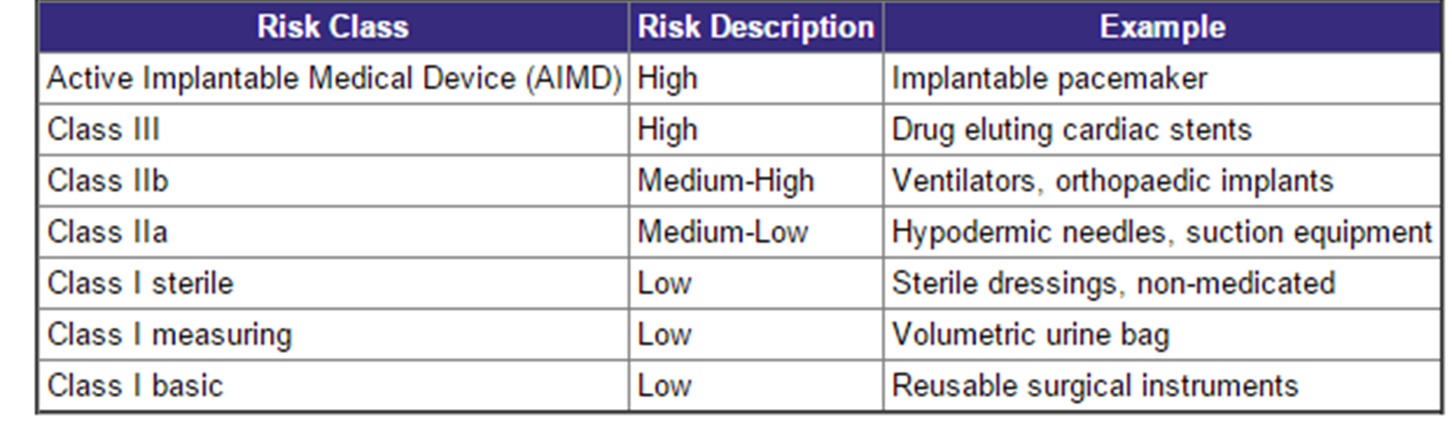
Examples of risk classification (repeat from 17.1)
(GHTF guidelines)
©
Concepts of Safety and Risk Management
dr. Chris R. Mol, BME, NORTEC, 2015

Slide 13
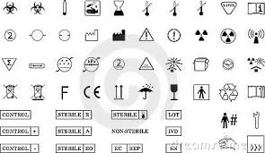
Marketing and Sales Control
EU Labelling
The primary purpose of labelling is
  to identify the medical device and its manufacturer
  to communicate safety and performance related information to the user, professional or lay, or other person, as appropriate.
Such information may appear on the device itself, on packaging or as instructions for use.
Certified medical devices should have the CE mark on the packaging, insert leaflets, etc..
This packaging should also show harmonised pictograms and standardised logos to indicate essential features such as instructions for use, expiry date, manufacturer, sterile, don't reuse, etc.
©
Government Regulatory Agencies
dr. Chris R. Mol, BME, NORTEC, 2015

Slide 14
Marketing and Sales Control
EU Labelling: selection of regulations
The medium, format, content, legibility, and location of the label and instructions for use should be appropriate to the particular device, its intended purpose and the technical knowledge, experience, education or training of the intended user(s).
Provided that safe and correct use of the device is ensured, a RA may authorise labelling to be in one or more language(s) other than its national language(s).
Labels should be provided in a human-readable format but may be supplemented by machine-readable forms, such as radio-frequency identification (RFID) or bar codes.
©
Government Regulatory Agencies
dr. Chris R. Mol, BME, NORTEC, 2015

Slide 15
Marketing and Sales Control
EU Labelling: Instructions for Use
Instructions for use should be written in terms readily understood by the intended user and, where appropriate, supplemented with drawings and diagrams. Some devices may include separate information for the professional user and the lay person.
Instructions for use may be provided to the user either in paper or non-paper format (e.g. electronic). They may be supplied by various means either with the medical device or separate from it. Examples of other means are information displayed on a screen incorporated into the device, information downloaded from the manufacturer’s web site using the internet, and machine-readable sources.
Residual risks which are required to be communicated to the user and/or other person should be included as limitations, contraindications , precautions or warnings in the labelling.
Instructions for use may not be needed or may be abbreviated for devices if they can be used safely and as intended by the manufacturer without any such instructions for use.
©
Government Regulatory Agencies
dr. Chris R. Mol, BME, NORTEC, 2015

Slide 16
Use Control
Medical Device Post-Market Surveillance and Vigilance
Medical Devices Directive (MDD 93/42/EEC - Article 10 and Annexes II, IV, V, VI, VII). In addition, the quality management standards, ISO 9001:2000 and ISO 13485:2003, as well as the risk management standard ISO 14971 (3), also include requirements for medical device manufacturers to conduct post-market activities.
Medical device post-market surveillance is not only regulatory-driven, but should also be considered as good business practice. It helps the manufacturer to obtain an understanding of the performance of the device once placed on the market and provides continuous feedback that enables manufacturers to maintain a high standard of product quality and consumer satisfaction. It also helps to minimize exposure arising from incidents through effective warning and product recall processes and procedures.
©
Government Regulatory Agencies
dr. Chris R. Mol, BME, NORTEC, 2015

Slide 17
Use Control
Medical Device Post-Market Surveillance and Vigilance
Post-market activities can be divided in two categories:
  Post Market Surveillance: the pro-active collection of information on quality, safety or performance of Medical Devices after they have been placed on the market
Vigilance: (reactive) refers to incidents that can occur with medical devices when they do not perform as intended, thereby leading in the worst case to injury or death. The medical device directives require timely, coordinated action and provision of information between the manufacturer and the Member States' national authorities in relation to (near) incidents that are related to the device.
  The purpose of medical device vigilance is to protect the health and safety of persons within the EU, evaluate incidents to prevent recurrence; determine the effectiveness of corrective actions and preventive actions; and monitor and learn from experience.
©
Government Regulatory Agencies
dr. Chris R. Mol, BME, NORTEC, 2015

Slide 18
Use Control
Medical Device Post-Market Surveillance and Vigilance
The Competent Authority will hold accountable the person (in most cases, the manufacturer) who was responsible for affixing the CE marking to a non-compliant product. Others who are responsible for the non-compliance of the product will be held accountable as well.
Penalties, which may include draconian sanctions such as imprisonment, are determined by national law.
Competent Authorities are able to monitor products placed on the market by either of the following means:
  reviewing product claims
  evaluating and investigating reported complaints
  auditing Notified Bodies
  exchanging information among Competent Authorities
  visiting commercial, industrial and storage premises on a regular basis
  visiting work places and other premises where products are put into service and used
  organizing random audits
  acquiring samples of products and subjecting them to examination and testing disclosure of all necessary (technical) information
©
Government Regulatory Agencies
dr. Chris R. Mol, BME, NORTEC, 2015

Slide 19
USA

Slide 20
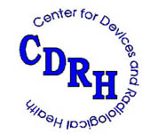
FDA: the Food and Drug Administration
The Food and Drug Administration (FDA) is a federal agency of the United States Department of Health and Human Services. The FDA is responsible for protecting and promoting public health through the regulation and supervision of medical (a.o.) devices.
The Center for Devices and Radiological Health (CDRH) is the branch of the FDA responsible for:
  regulating firms who manufacture, repackage, relabel, and/or import medical devices sold in the United States.
  the pre-market approval of all medical devices, as well as overseeing the manufacturing, performance and safety of these devices.
(In addition, CDRH regulates radiation-emitting electronic products (medical and non-medical) such as lasers, x-ray systems, ultrasound equipment, microwave ovens and color televisions.)
©
Government Regulatory Agencies
dr. Chris R. Mol, BME, NORTEC, 2015

Slide 21
Product Classification
Under the Food, Drug, and Cosmetic Act, the U.S. Food and Drug Administration recognizes three classes of medical devices, based on the level of control necessary to assure safety and effectiveness.
The USFDA allows for two regulatory pathways that allow the marketing of medical devices.
The first, and by far the most common is the so-called 510(k) process. A new medical device that can be demonstrated to be "substantially equivalent" to a previously legally marketed device can be "cleared" by the FDA for marketing as long as the general and special controls are met. The vast majority of new medical devices (99%) enter the marketplace via this process. The 510(k) pathway rarely requires clinical trials.
The second regulatory pathway for new medical devices is the Premarket Approval process, which is similar to the pathway for a new drug approval. Typically, clinical trials are required for this premarket approval pathway.
©
Government Regulatory Agencies
dr. Chris R. Mol, BME, NORTEC, 2015

Slide 22
Device Attributes
Product Control
The Food and Drug Administration (FDA) has established classifications for approximately 1,700 different generic types of devices and grouped them into 16 medical specialties referred to as panels. Each of these generic types of devices is assigned to one of three regulatory classes based on the level of control necessary to assure the safety and effectiveness of the device.
Device classification depends on the intended use of the device and also upon indications for use.
  For example, a scalpel's intended use is to cut tissue. A subset of intended use arises when a more specialized indication is added in the device's labelling such as, "for making incisions in the cornea".
Classification is risk based, that is, the risk the device poses to the patient and/or the user is a major factor in the class it is assigned. Class I includes devices with the lowest risk and Class III includes those with the greatest risk.
Indications for intended use can be found in the device's labelling,
but may also be conveyed orally during sale of the product.
©
Government Regulatory Agencies
dr. Chris R. Mol, BME, NORTEC, 2015

Slide 23
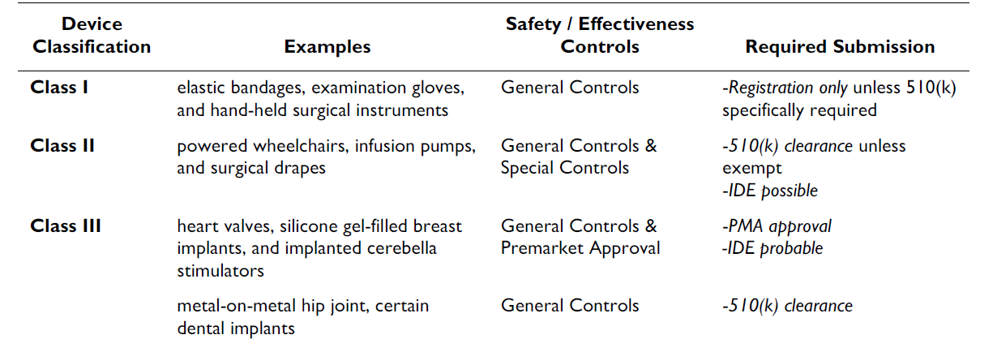
FDA: Medical Device Classification
IDE: Initial Device Exemption gives the possibility to test a new system on the market before getting 510(k) clearance
©
Government Regulatory Agencies
dr. Chris R. Mol, BME, NORTEC, 2015

Slide 24
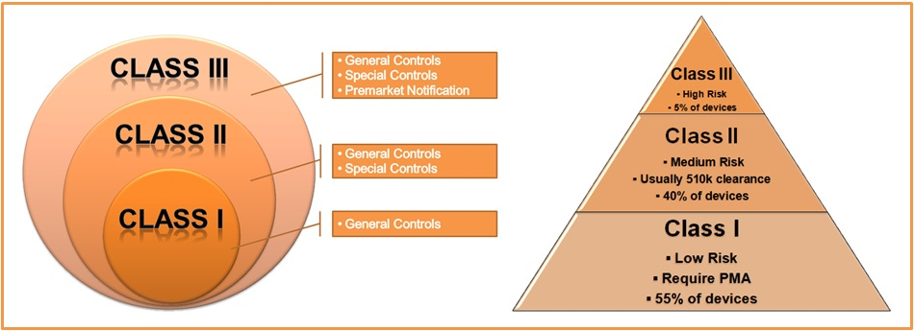
FDA Controls
©
Government Regulatory Agencies
dr. Chris R. Mol, BME, NORTEC, 2015

Slide 25
FDA: General Controls
General controls are the minimum regulations that apply to all FDA regulated medical devices, including Class I devices.
These include five elements:
establishment registration — for e.g. manufacturers, distributors and foreign firms
device listing — listing with FDA of all devices to be marketed;
good manufacturing practices (GMP)—manufacturing of devices in accordance with the Quality Systems Regulation (QSR)
labelling — labelling of devices or in vitro diagnostic products;
premarket notification — submission to FDA of a premarket notification 510(k).
©
Government Regulatory Agencies
dr. Chris R. Mol, BME, NORTEC, 2015

Slide 26
FDA: General controls with Special controls
In addition to complying with general controls, Class II devices are also subject to special controls. Special controls include:
    special labelling requirements
    mandatory performance standards
    post-market surveillance
Devices in Class II are held to a higher level of assurance than Class I devices, and are designed to perform as indicated without causing injury or harm to patient or user.
©
Government Regulatory Agencies
dr. Chris R. Mol, BME, NORTEC, 2015

Slide 27
FDA: General controls, Special controls and Pre-Market Approval
A Class III device is one for which insufficient information exists to assure safety and effectiveness solely through the general or special controls sufficient for Class I or Class II devices.
Such a device needs premarket approval, a scientific review to ensure the device's safety and effectiveness, in addition to the general controls of Class I.
Class III devices are usually those that support or sustain human life, are of substantial importance in preventing impairment of human health, or present a potential, unreasonable risk of illness or injury. Examples of Class III devices that require a premarket notification include implantable pacemaker, pulse generators, HIV diagnostic tests, automated external defibrillators, and endosseous implants.
©
Government Regulatory Agencies
dr. Chris R. Mol, BME, NORTEC, 2015

Slide 28
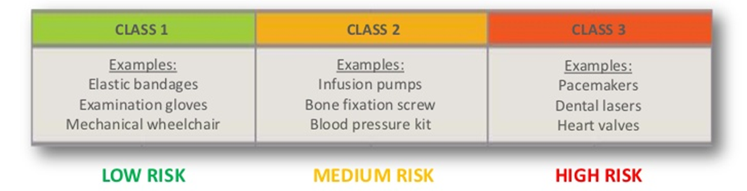
Pre Market Notification
Product Control
In the USA, the manufacturer of the device receives a Marketing Clearance (510K) or an Approval Letter (PMA) from the FDA.
  most Class I devices are exempt from Premarket Notification 510(k)
  most Class II devices require Premarket Notification 510(k)
  most Class III devices require Premarket Approval.
©
Government Regulatory Agencies
dr. Chris R. Mol, BME, NORTEC, 2015

Slide 29
Product Control
FDA: Manufacturing
Like drug manufacturers, medical device manufacturers must produce their devices in accordance with Good Manufacturing Practice (GMP). The GMP requirements for devices are described in the QSR (Quality System Requirements).
The QSRs require that domestic or foreign manufacturers have a quality system for the design, manufacture, packaging, labeling, storage, installation, and servicing of non-exempt finished medical devices intended for commercial distribution in the United States.
The regulation requires:
    that various specifications and controls be established for devices;
    that devices be designed and manufactured under a quality system to meet these specifications;
    that finished devices meet these specifications;
    that devices be correctly installed, checked and serviced;
    that quality data be analyzed to identify and correct quality problems;
    that complaints be processed.
FDA monitors device problem data and inspects the operations and records of device developers and manufacturers to determine compliance with the GMP requirements.
©
Government Regulatory Agencies
dr. Chris R. Mol, BME, NORTEC, 2015

Slide 30
Product Control
FDA: labelling
Like drugs and biological products, all FDA approved or cleared medical devices must be labelled in a way that informs a user of how to use the device. “Labelling” is defined as
“all labels and other written, printed, or graphic matter upon any article or any of its containers or wrappers, or accompanying such article”
at any time while a device is held for sale after shipment or delivery for shipment in interstate commerce.
The term “accompanying” is interpreted to mean more than physical association with the product; it extends to posters, tags, pamphlets, circulars, booklets, brochures, instruction books, direction sheets, fillers, webpages, etc. Accompanying can also include labelling that is connected with the device after shipment or delivery for shipment in interstate commerce.
According to an court decision, “most, if not all” advertising is labelling.
©
Government Regulatory Agencies
dr. Chris R. Mol, BME, NORTEC, 2015

Slide 31
Use Control
FDA: Adverse Event Reporting
The Safe Medical Devices Act of 1990 required FDA to establish a system for monitoring and tracking serious adverse events that resulted from the use or misuse of medical devices. The Medical Device Reporting (MDR) regulation is the mechanism that FDA and manufacturers use to identify and monitor significant adverse events involving medical devices, so that problems are detected and corrected in a timely manner.
Device manufacturers are required to report to FDA
  within 30 calendar days of acquiring information that reasonably suggests one of their devices may have caused or contributed to a death, serious injury, or malfunction and
  within 5 working days if an event requires action other than routine maintenance or service to prevent a public health issue.
  User facilities, such as hospitals, are required to report deaths and serious injuries to both the manufacturer, if known, and FDA within 10 working days. User facilities must also submit annual reports to FDA of all adverse event reports sent to manufacturers or FDA in the past year.
©
Government Regulatory Agencies
dr. Chris R. Mol, BME, NORTEC, 2015

Slide 32
Use Control
FDA: Medical Device Tracking
Manufacturers are required to track certain devices from their manufacture through the distribution chain when they receive an order from FDA to implement a tracking system for a certain type of device.
The purpose of device tracking is to ensure that manufacturers of these devices can locate them quickly once in commercial distribution if needed to facilitate notifications and recalls in the case of serious risks to health presented by the devices.
FDA may issue a tracking order for any Class II or Class III device:
    the failure of which would be reasonably likely to have serious adverse health consequences;
    which is intended to be implanted in the human body for more than one year; or
    which is intended to be a life sustaining or life supporting device used outside a device user facility.
©
Government Regulatory Agencies
dr. Chris R. Mol, BME, NORTEC, 2015

Slide 33

END
The creation of this presentation was supported by a grant from THET:
see https://www.thet.org/

